Slide 1


CONSULTING
EXPERIENCE
PROJECT
Task-1
Company and Industry Analysis
Team Name: Milk Basket(Group 18)

Slide 2
Team Name- Company selected
Names of team members:
P S Priti Sudha
Swati Jalan
Shrikant Sagat
Vikrant Singh
Rahul Gouri
Shubham Bindal

Slide 3
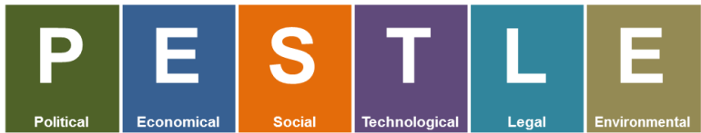
High government investment on ICT infrastructure.
Government intervention.
Digital India
Tax policy
Trade restrictions
Exchange rate.
Economic condition: Weak economic condition would limit the growth of revenue.
Interest rate
GDP trends affects the industry.
Online spending is expected to grow.
Lifestyle attitudes.
Cultural barriers.
Inclination towards milk products in Indian lifestyle.
Population age.
Growth of internet.
Rapid development of high-speed network service.
Third party online payment system.
Ease of ordering and reordering.
Strategy developed which have to comply with different legal obligations domestically and internationally
Employment laws.
Consumer protection laws
Health and safety laws.
Discrimination laws.
Global warming and pollution awareness increase globally.
Promoting biodegradable packaging.
Recyclable and Reusable bottles.

Slide 4
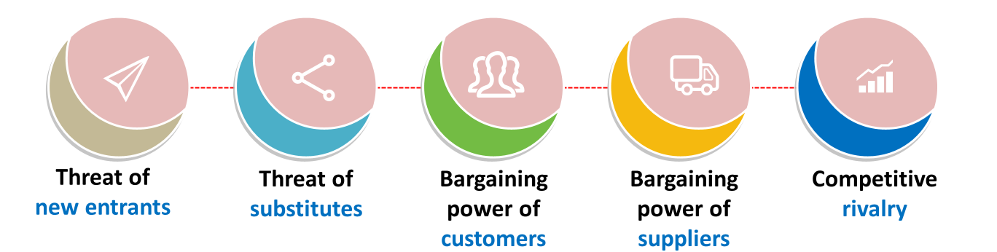
High
Low entry costs
Depend on individual interests.
High cost of infrastructure and operations.
High
Search engines and price-comparison websites moving into online retailing and auctions.
High bargaining power.
Other options.
Professional buyers.
Price comparison.
High
No delivery charge.
High
Competitors from different backgrounds like BB Daily, Super Daily, Grofers, entered the market.

Slide 5
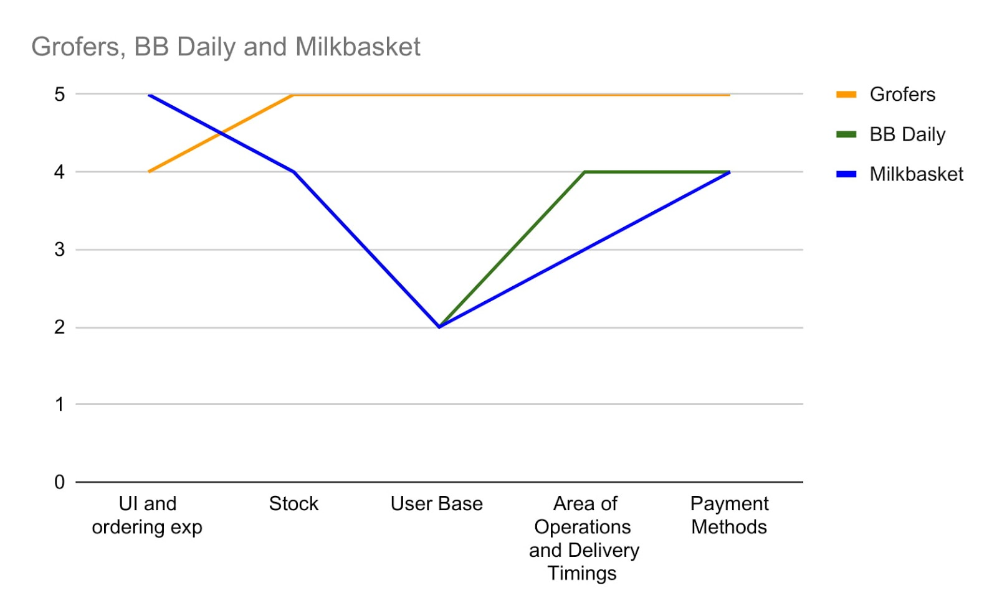
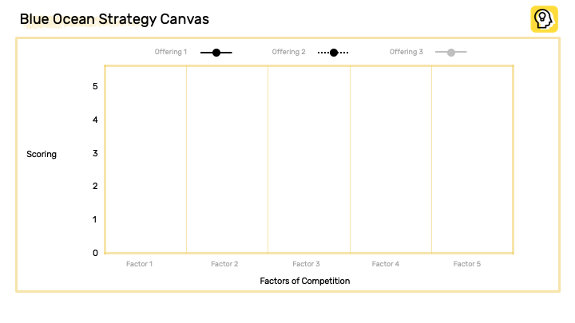

Slide 6
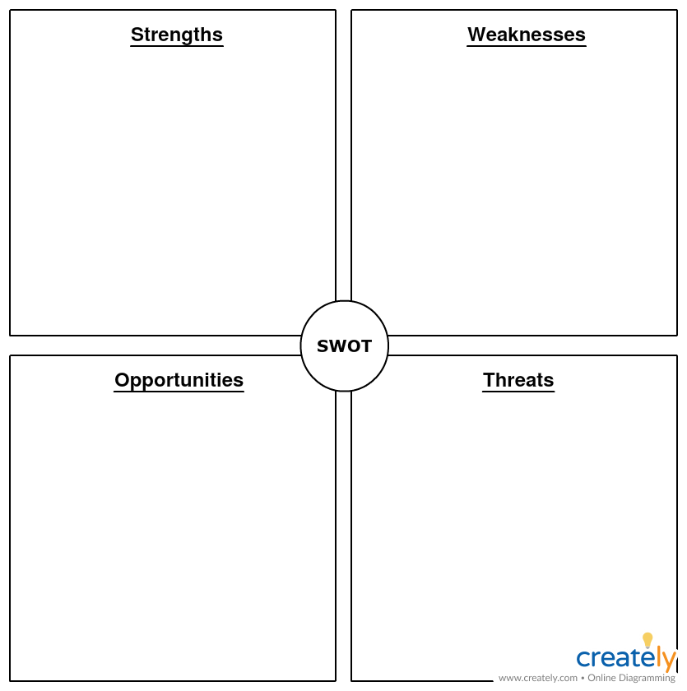
Prepaid model
Customer retention rate(98%)
Efficient supply chain
A first company in organized fresh milk e-model.
7 am delivery.
No minimum amount.
Powerful investors like Blume ventures, Kalaari Capital, Lenovo Capital, etc.
Thin profit margin in products.
Less presence on Social Media.
Customer interface of App is of old style.
Limited area of servicing.
Post paid facility is not available.
100 Billion opportunity till 2030.
Customer belief of online purchase is increasing.
The internet is becoming cheaper year on year.
Increase in diversity of products.
Expansion to new areas.
Large market size to be captured.
Big companies like Bigbasket, Grofers and Amazon prime will soon enter this business. Threat of competition from similar service providers.
Traditional Dairy’s and Retail Stores.

